Slide 1
A year in the life of HP Security research
Mark Painter (@secpainter) HP Enterprise Security Products Security Evangelist
June 2015

Slide 2

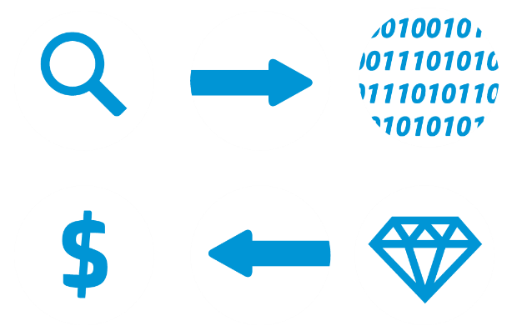
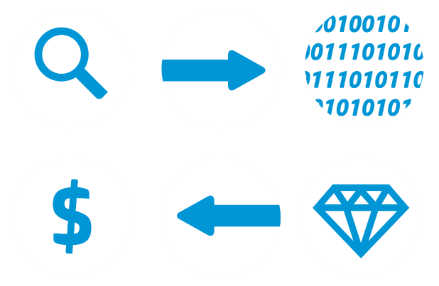

Attack Life Cycle
Research
Infiltration
Research Potential Targets
Phishing Attack and Malware
Data Sold on Black Market
Monetization
Discovery
Mapping Breached Environment
Exfiltration/Damage
Capture
Exfiltrate/Destroy Stolen Data
Obtain data

Slide 3
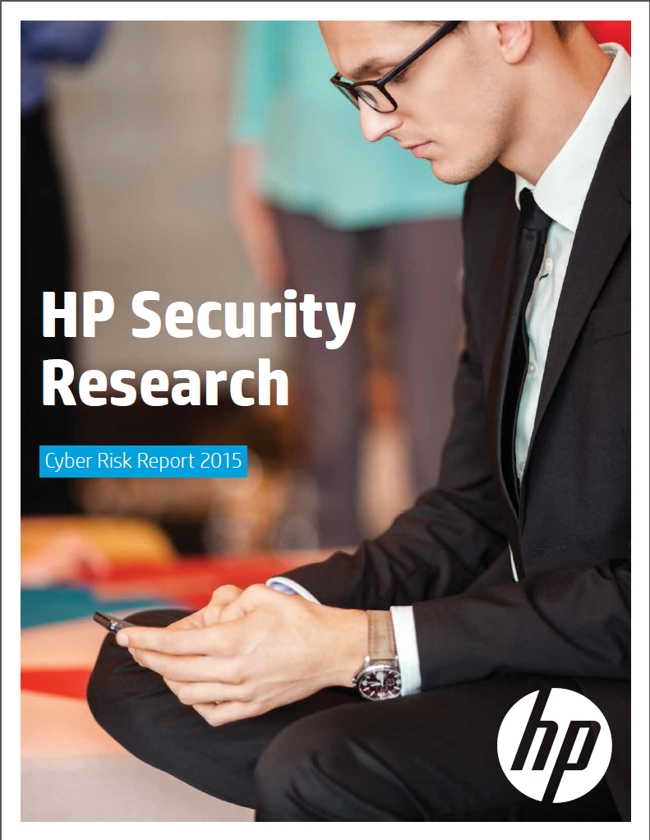



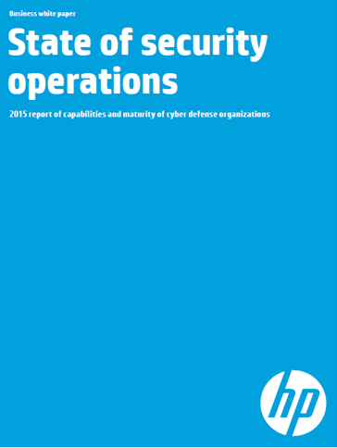



A year in the life of HP Security research
ESS

Slide 4
130%
Since 2009, time to resolve an attack has grown

Slide 5
229
^{days}
average time to detect breach
2013 January February March April May June July August September October November December 2014 January February March April

Slide 6
HP and Ponemon Institute studies
Year | Attacks per Week | Average US costs | Time to resolve
2010 | 50 | $3.8m | 14 days
2011 | 72 | $8.4m | 18 days
2012 | 102 | $8.9m | 24 days
2013 | 122 | $11.6m | 32 days
2014 | 138 | $12.7m | 45 days
Notes:
Ponemon - 59 benchmarked organizations
Costs = 96% increase in just four years
#of successful attacks = 144% increase

Slide 7
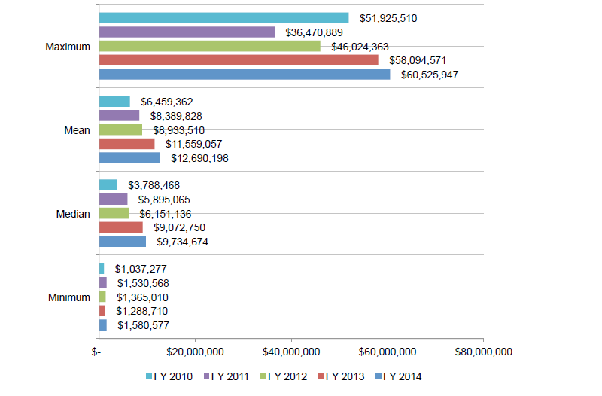
HP and Ponemon Institute studies
Cost of cyber crime
Notes:
$1.6 million to $61 million

Slide 8
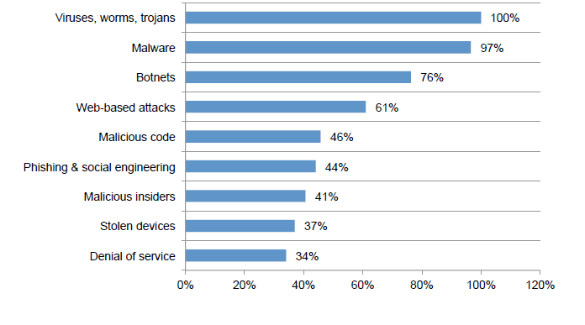
HP and Ponemon Institute studies
Types of Attacks experienced by benchmarked companies

Slide 9
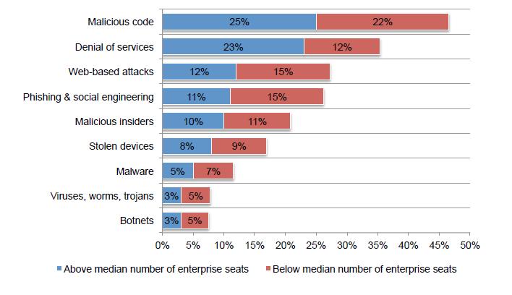
HP and Ponemon Institute studies
Costs of attacks versus organizational size
Notes:
small organizations incur a significantly higher per capita cost than larger organizations ($1,513 versus $517).
The most costly cyber crimes are those caused by denial of services, malicious insiders and malicious code. These account for more than 55 percent of all cyber crime costs per
organization on an annual basis.

Slide 10
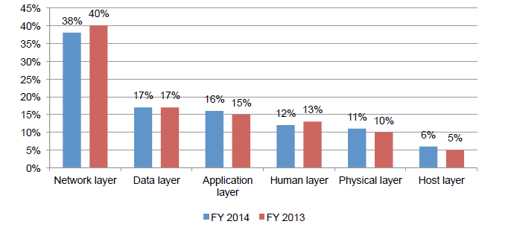
HP and Ponemon Institute studies
Budget per layer

Slide 11
Risk Report

Slide 12

Key Finding #1
Well-known attacks are still commonplace.

Slide 13
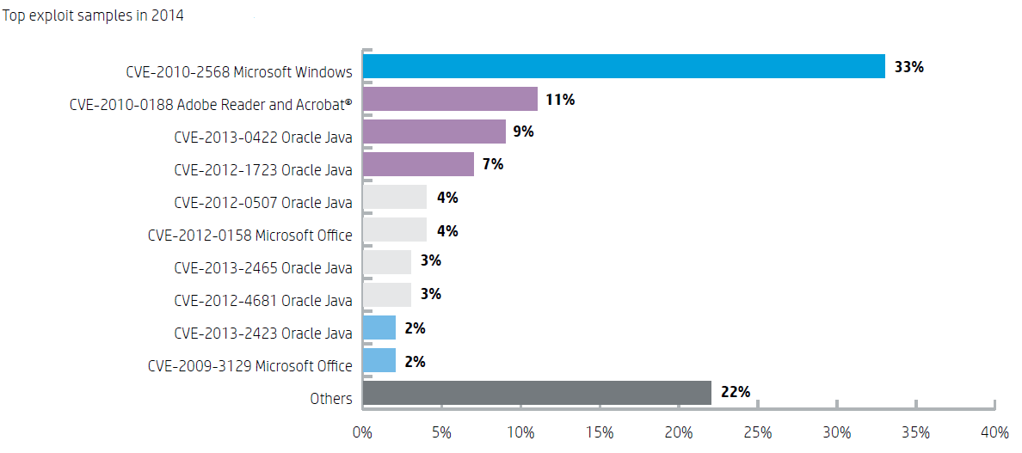
Old vulns still going strong

Slide 14
Takeaway
Network defenders should employ a comprehensive
patching strategy to ensure systems are up-to-date
on their protections.

Slide 15

Key Finding #2
Misconfigurations are still a significant problem.

Slide 16
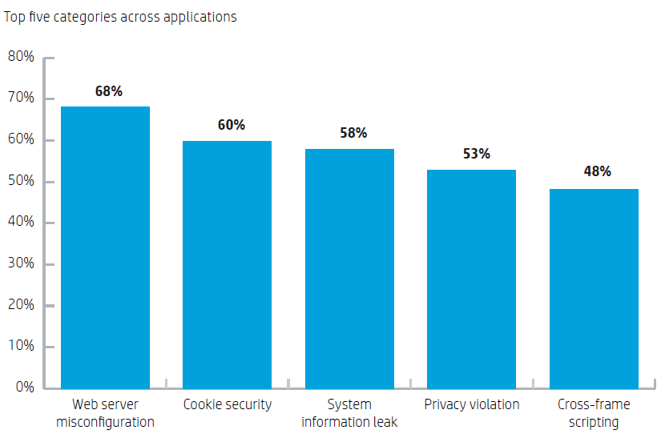
Misconfigurations are too common
Notes:
6500 Web applications
Some flavor of xss was in another 37%

Slide 17
Takeaway
Our findings show that server misconfigurations, not
bugs in code, are the most common security problem facing enterprises today.

Slide 18

Key Finding #3
Newer technologies such as mobile and the Internet of Things introduce new avenues of attack.

Slide 19
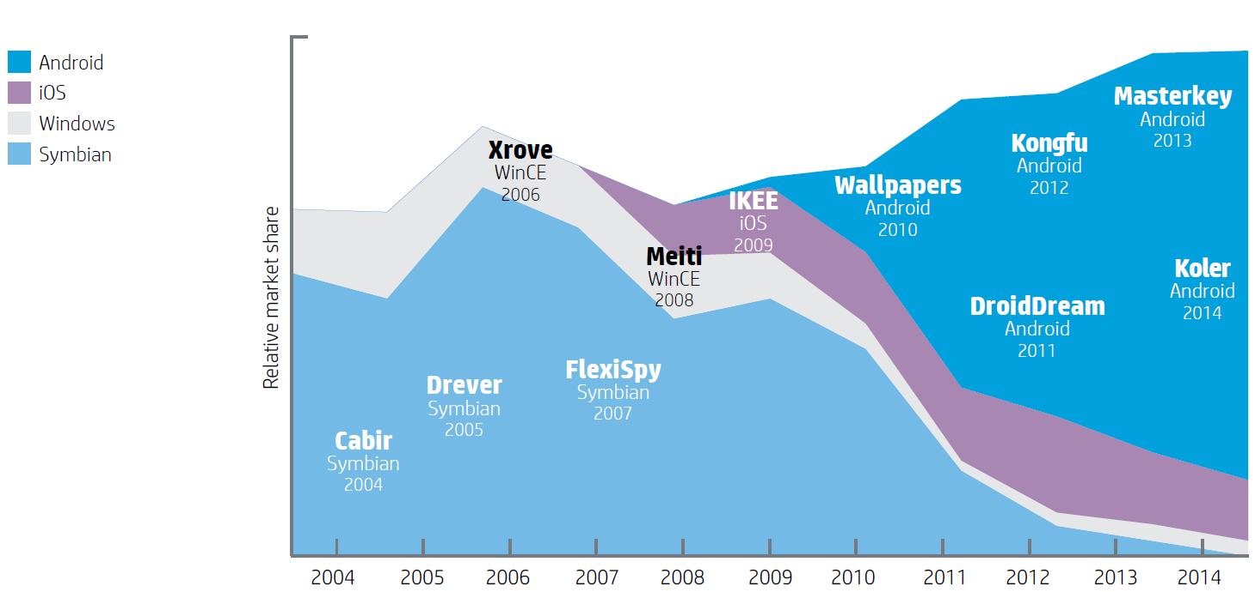
10 years of mobile malware
>1M unique malicious apps known today
Notes:
Exponential growth in the number of discovered malicious apps – majority target Android.
Reporting varies but general consensus is >1M unique malicious apps known today

Slide 20
Notable Android malware in 2014
One attack used Web injections and social engineering to install fake banking apps onto smartphones.
Ransomware
SMS Scams
Mobile Trojans
Notes:
The most notable Android malware from 2014 fell into three categories:
Ransomware is a type of malware that restricts access to the computer system it infects, and demands a ransom to be paid to the malware creator in order to remove the restriction. In 2014 we saw the first purposefully built mobile ransomware, with functionality that prevented the infected devices from working; Tlock was the first ransomware and was discovered in April. We’ll be looking more closely at the research our team performed on Tlock in a few minutes.
Sending SMS messages to premium-line numbers was the first payload used by Android malware writers. This technique was particularly useful in Europe, where SMS still remains one of the more popular services allowing vendors to monetize their services (allowing users to pay for small items such as ringtones by sending SMS messages).
Mobile Trojans infect user devices by attaching themselves to seemingly harmless or legitimate programs, are installed with the app and then carry out malicious actions. Such programs have captured user login information from mobile banking apps.

Slide 21
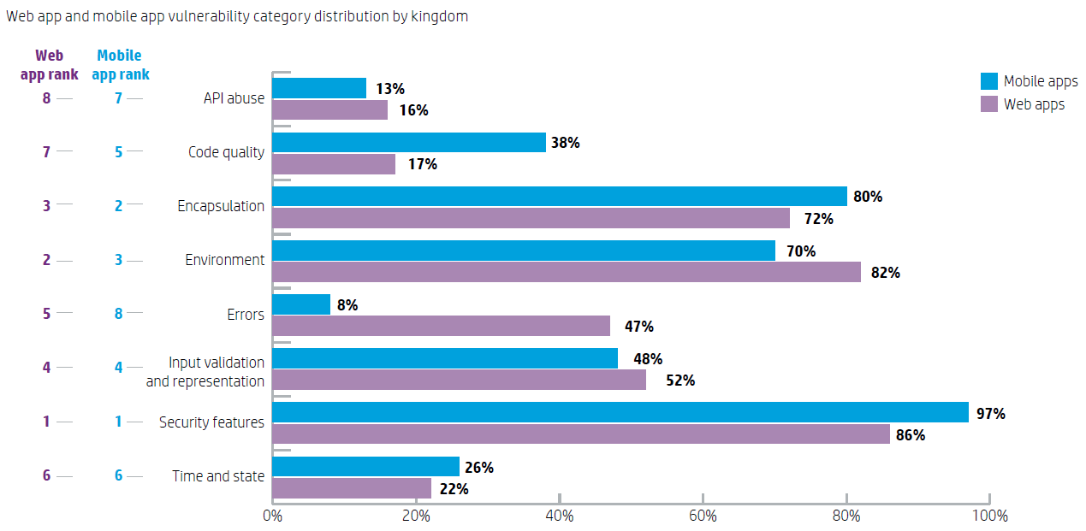
Web vs Mobile

Slide 22
Takeaway
Not only has new technology introduced new
attack surfaces and other security challenges, many developers are making the kinds of mistakes the world
of traditional computing has already figured out.

Slide 23

Key Finding #4
Determined adversaries are proliferating.

Slide 24
Takeaway
Adversaries use both old and new vulnerabilities to penetrate all traditional levels of defense. Defenders must consider how global events might affect them.

Slide 25

Key Finding #5
Secure coding continues to pose challenges, years after the introduction of secure-coding practices for the industry.

Slide 26
Takeaway
Research indicates that most vulnerabilities stem from
a relatively small number of common, well-understood software programming errors.
Notes:
Xsrf – 48% - x frames option header

Slide 27

Key Finding #6
Complementary protections fill out coverage.

Slide 28
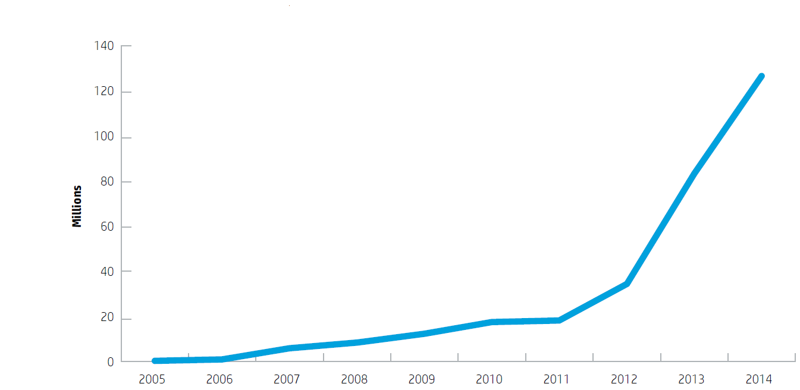
Even the best protections can’t do it alone
HP Cyber Risk Report 2015
Notes:
AV-Test instances of unique malware. . For 2014, the estimated total is 140 million samples. For 2015, it’s over 200 million.

Slide 29
Takeaway
There is no silver bullet.
Layered technologies work best, especially when paired with the mentality that assumes a breach will occur.

Slide 30
Going beyond the basics of best practices
Don’t rely solely on traditional defensive perimeter security alone.
Remember that your organization exists in the wider world and is affected by external events.
Assume breach; now what?

Slide 31
Going beyond the basics of best practices
Understand that not all information and network assets are equal.
Make security and response a continuous process.
Seek out credible and reliable security intelligence.

Slide 32
Internet of Things Research Study

Slide 33

The most important security story of 2014
Notes:
Industrial blast furnace

Slide 34
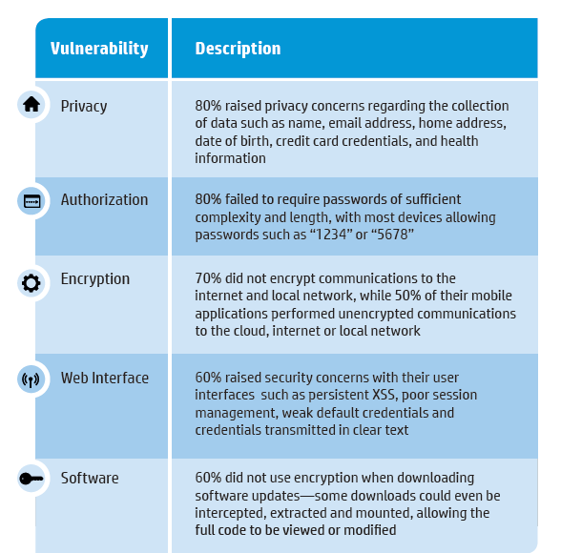
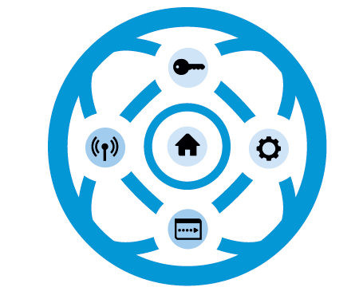
Report Findings

Slide 35

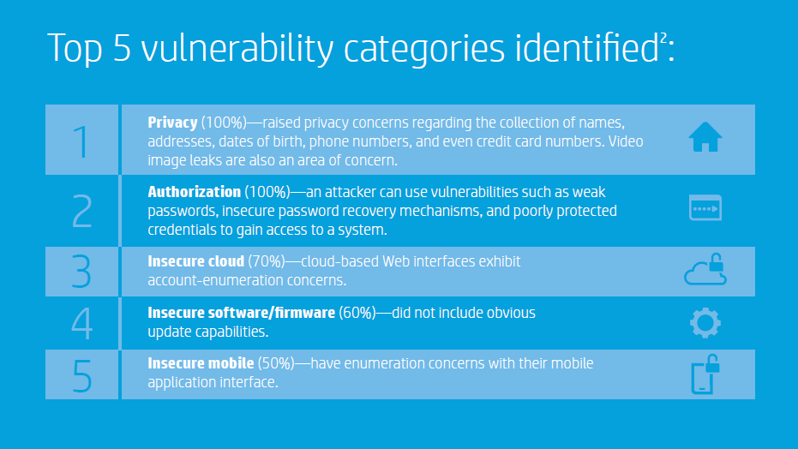

Internet of Things
Home Security Systems Research Findings
Notes:
100% vulnerable to account harvesting

Slide 36
State of Security Operations

Slide 37
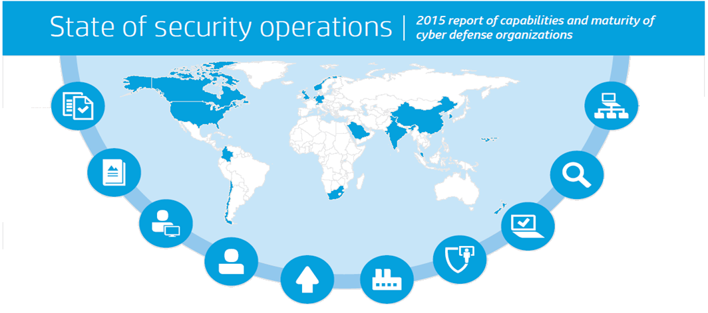
118 assessments . 87 organizations . 18 countries

Slide 38
Maturity and Capability Levels
Assessment methodology
Maturity & capability levels
Level 0
Incomplete
Level 1
Performed
Level 2
Managed
Level 3
Defined
Level 4
Measured
Level 5
Optimized
Quantitative assessment of business, people, process and technology
Based on Carnegie Mellon – Software Engineering Institute’s - Capability Maturity Model for Integration (SEI-CMMI)
Year-to-year trends and comparisons across industries
Effectiveness
Maturity
Notes:
Repeatable process
38

Slide 39
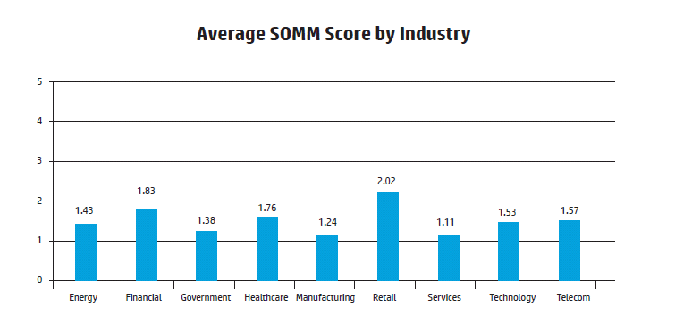
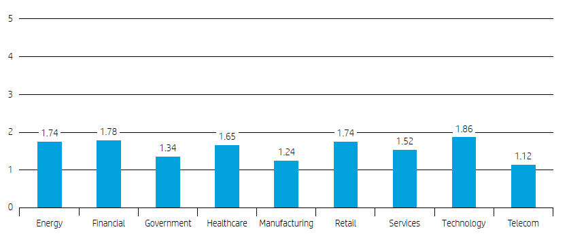
Median SOMM Score by Industry

Slide 40
Key Takeaways
#1 concern of cyber defense team leadership is attracting and retaining skilled resources.
0% of Cyber Defense teams achieving minimum security monitoring capabilities without a SIEM: ZERO
20% of SOCs are not meeting minimum security threat detection and response capabilities
87% of SOCs are not meeting recommended maturity and capability levels

Slide 41
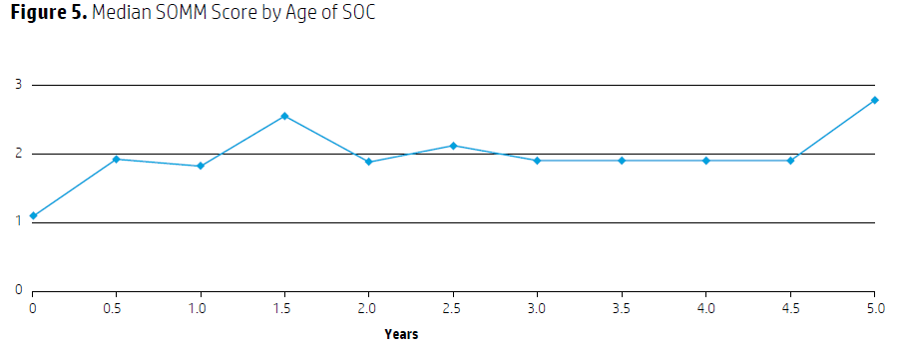
Security operations is a program, not a project
SOC maturity often peaks and then drops at about 18 months after inception, typically because of leadership changes and the end of project funding
Notes:
CISO average 2 years, 1st line analysts 1 year to 18 months

Slide 42
For more information…
HP Security:
hp.com/go/security
HP Security Research:
hp.com/go/HPSR
HP Enterprise Security Products blog:
hp.com/go/securityproductsblog

Slide 43
For more information…
HP 2015 Cyber Risk Report:
hp.com/go/cyberrisk
HP 2015 State of Security Operations:
hp.com/go/StateOfSecOPs
HP Internet of Things study:
hp.com/go/fortifyresearch/iot

